Slide 1

Genetic Focal Epilepsies
Dylan Brock, MD MA
Assistant Professor
Child Neurology & Neurogenetics
University of Louisville
Norton Children’s Neurosciences Institute

Slide 2

Header
Focal Epilepsies in Perspective
Notes:
Doing chronologically

Slide 3
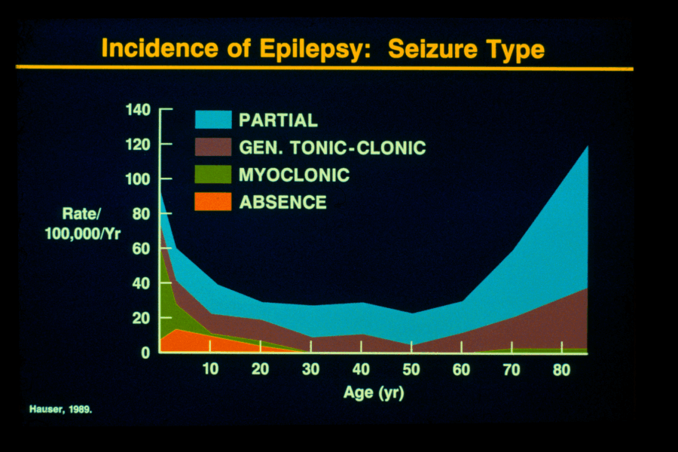
Header
Notes:
Doing chronologically

Slide 4
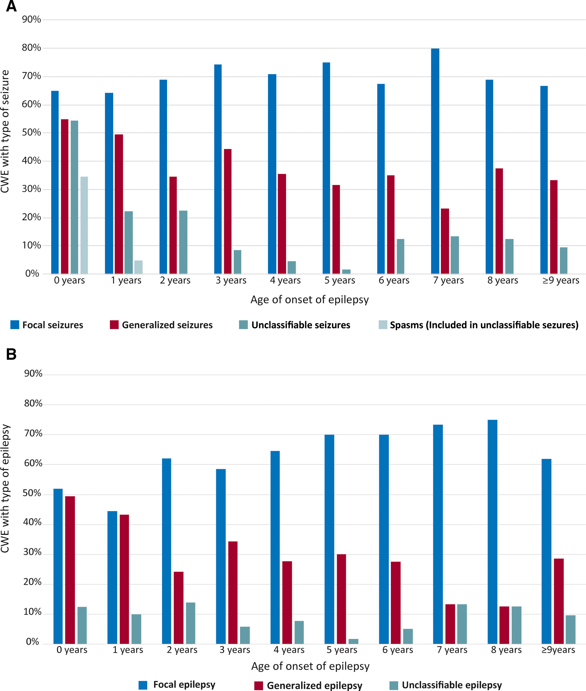
Header
Focal Seizures & Focal Epilepsy
In Children
Aaberg, K. M., Surén, P., Søraas, C. L., Bakken, I. J., Lossius, M. I., Stoltenberg, C., & Chin, R. (2017). Seizures, syndromes, and etiologies in childhood epilepsy: The International League Against Epilepsy 1981, 1989, and 2017 classifications used in a population-based cohort. Epilepsia. https://doi.org/10.1111/epi.13913
Notes:
Doing chronologically

Slide 5
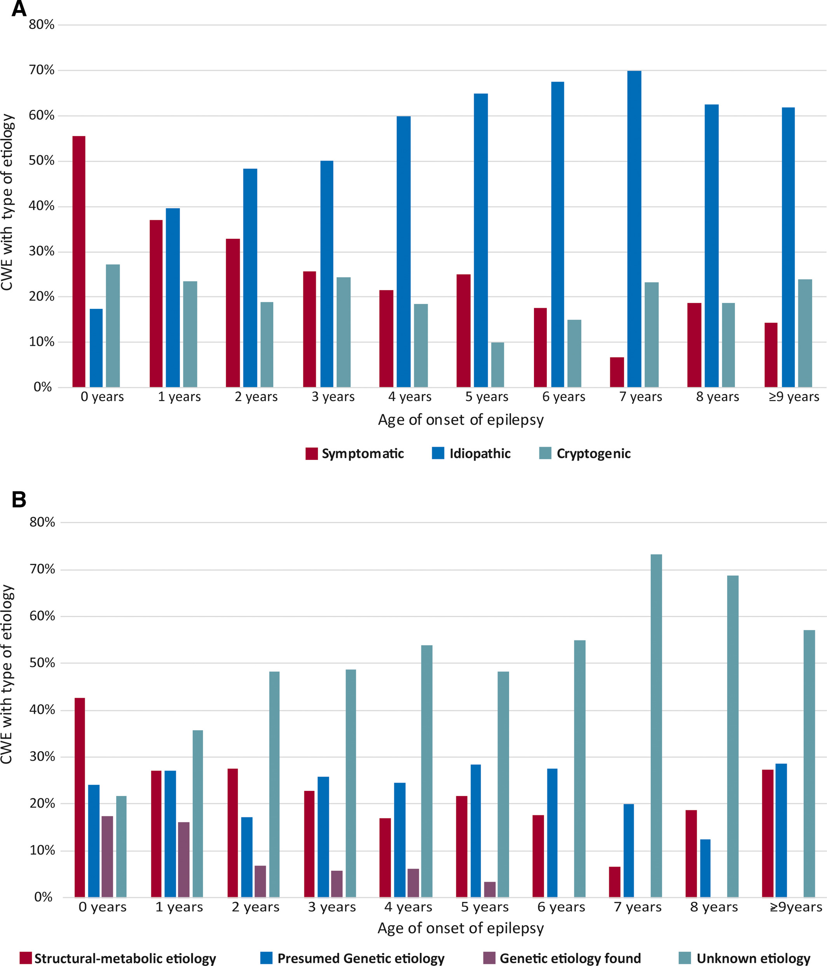
Header
Epilepsy Etiology
In Children
Aaberg, K. M., Surén, P., Søraas, C. L., Bakken, I. J., Lossius, M. I., Stoltenberg, C., & Chin, R. (2017). Seizures, syndromes, and etiologies in childhood epilepsy: The International League Against Epilepsy 1981, 1989, and 2017 classifications used in a population-based cohort. Epilepsia. https://doi.org/10.1111/epi.13913
Notes:
Doing chronologically

Slide 6
Header
Focal/Generalized Seizures
Focal/Generalized Epilepsy
Notes:
Doing chronologically

Slide 7
Header
Focal/Generalized Seizures
Focal/Generalized Epilepsy
What proportion patients with focal epilepsy have ‘generalized’ seizures?
What proportion of patients with ‘genetic generalized epilepsy’ also have occasional focal seizures?
What is this epilepsy with ‘combined’ seizures category?
Notes:
Doing chronologically

Slide 8
Header
Focal/Generalized Seizures
Focal/Generalized Epilepsy
What proportion patients with focal epilepsy have ‘generalized’ seizures?
~ 30%?
What proportion of patients with ‘genetic generalized epilepsy’ also have occasional focal seizures?
~ 20-40%?
What is this epilepsy with ‘combined’ seizures category?
Exactly!
Notes:
Doing chronologically

Slide 9
Header
Focal vs Genetic
Focal epilepsy is NOT synonymous with structural/lesional epilepsy
Genetic epilepsy may ALSO be structural/lesional epilepsy
Notes:
Doing chronologically

Slide 10
Header
Focal vs Genetic
Focal epilepsy is NOT synonymous with structural/lesional epilepsy
Genetic epilepsy may ALSO be structural/lesional epilepsy
Genetic Epilepsies may be EITHER Generalized OR focal
Notes:
Doing chronologically

Slide 11
Header
Focal vs Genetic
Focal epilepsy is NOT synonymous with structural/lesional epilepsy
Genetic epilepsy may ALSO be structural/lesional epilepsy
Genetic Epilepsies may be EITHER Generalized OR focal OR ‘BOTH’
Notes:
Doing chronologically

Slide 12
Header
Focal Seizures
Notes:
Doing chronologically

Slide 13
Header
Brief Philosophical Aside
Massimo Pigliucci: philosopher, evo biologist, challenges excessive reductionism
Asserts reductionism isn't always best approach
Advocates multi-level explanations (chem, bio, psych, etc) for complex phenomena
Supports emergentism: new properties at higher complexity
Endorses pluralistic approach to scientific study
Notes:
Doing chronologically

Slide 14
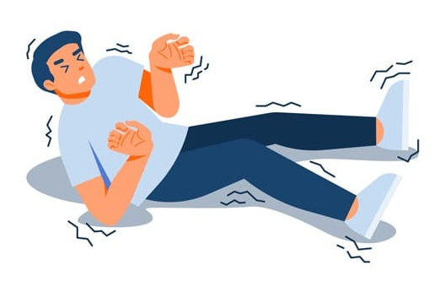

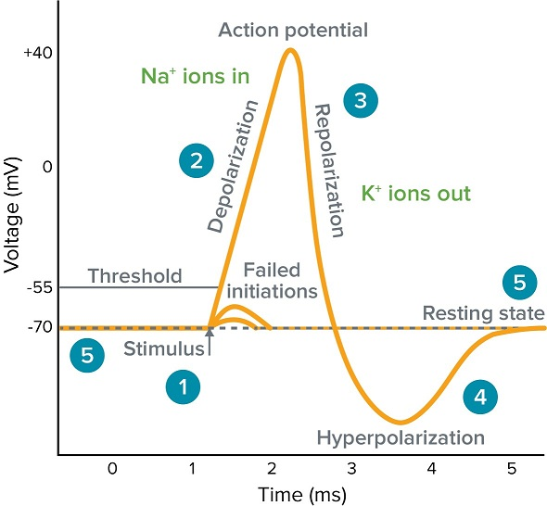
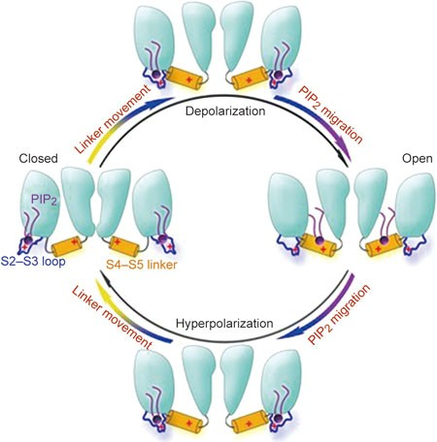
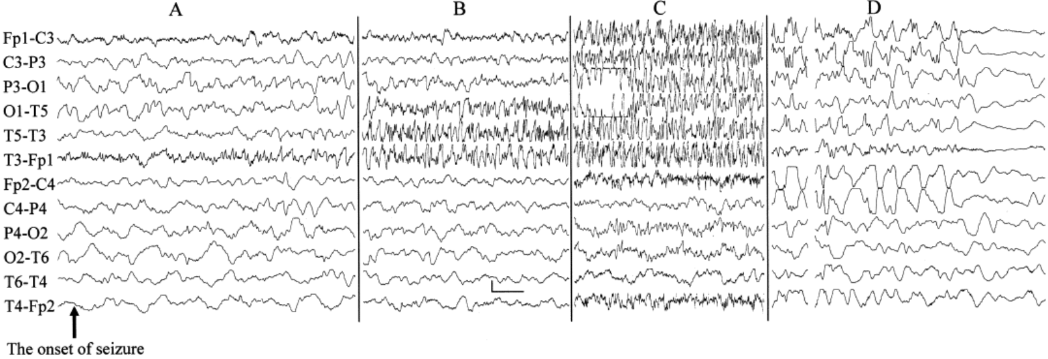
Header
Brief Philosophical Aside
Notes:
Doing chronologically

Slide 15
Lab diagnostics versus epilepsy diagnostics
Lab/Molecular Diagnostics vs Epilepsy Diagnoses
ClinGen
ILAE
MONDO
GCI
ILAE classification
HPO
Deep phenotyping
Genotype-phenotype correlations
SVI
ACMG criteria
Three-star variant
Lumping versus splitting
Historical classifications
Notes:
Doing chronologically

Slide 16
Header
[Talk] Focus:
A) Epilepsies of genetic etiology
with
B) Primarily focal-onset seizures
Notes:
Doing chronologically

Slide 17
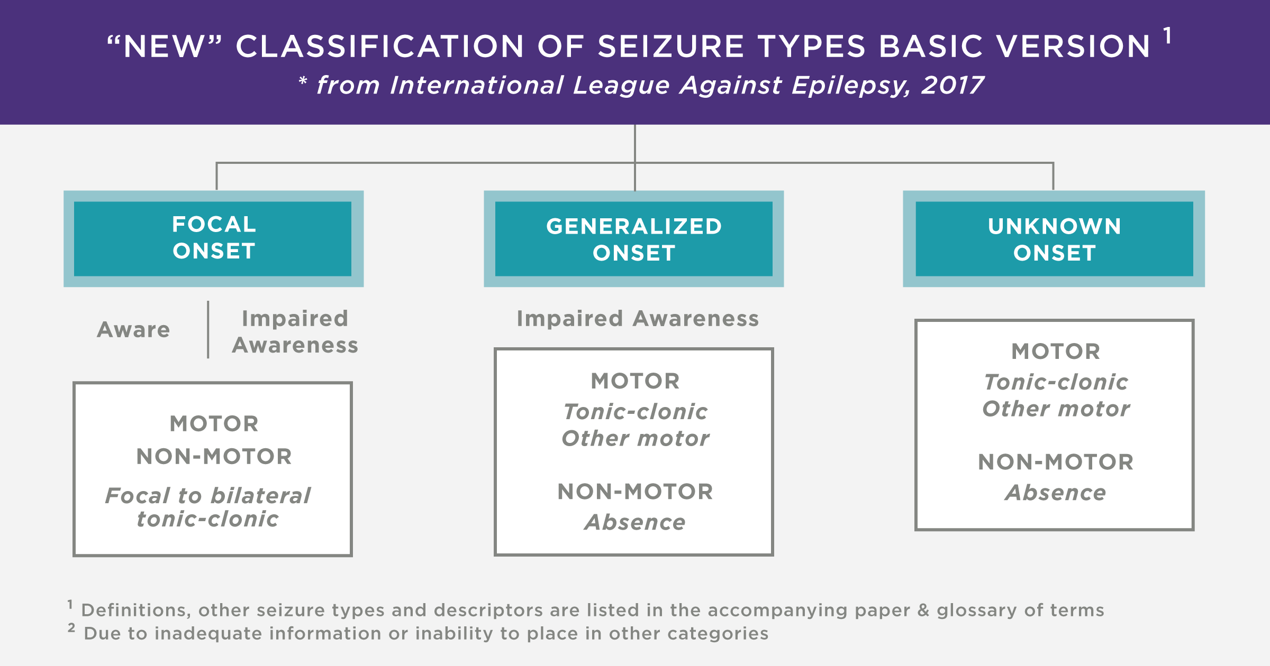
Header
[Talk] Focus:
A) Epilepsies of genetic etiology
with
B) Primarily focal-onset seizures
Notes:
Doing chronologically

Slide 18
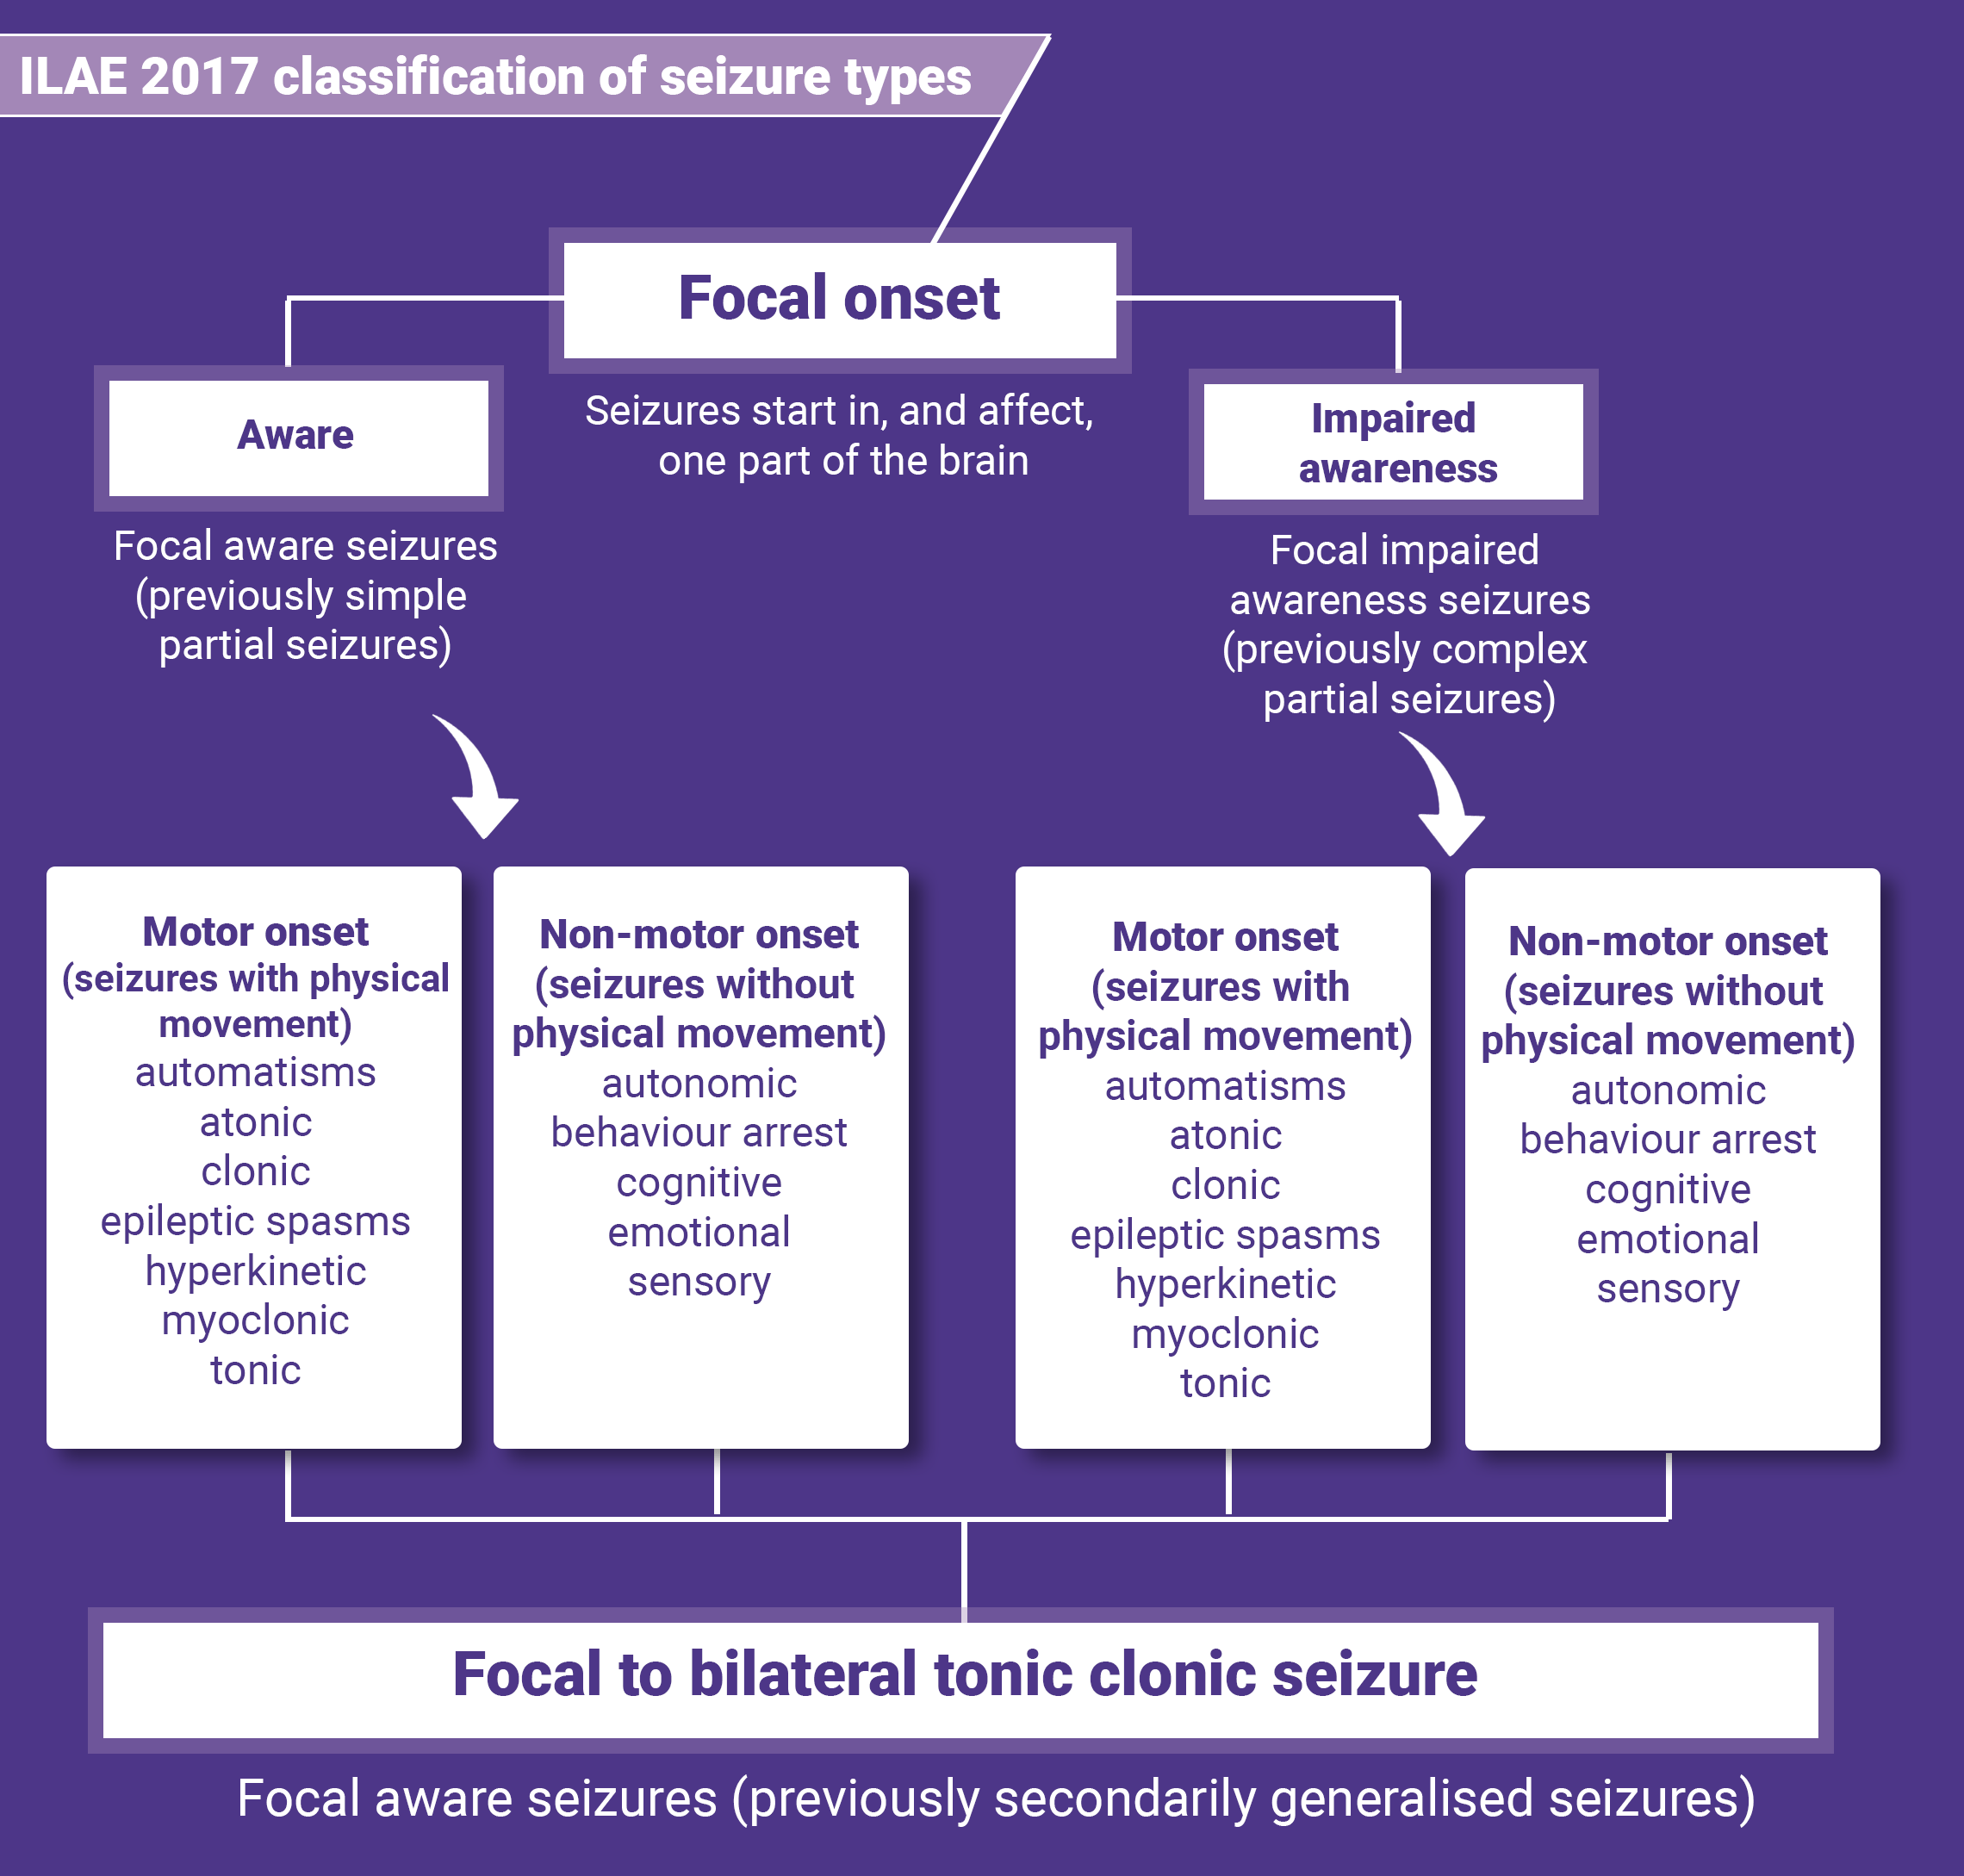
Header
[Talk] Focus:
A) Epilepsies of genetic etiology
with
B) Primarily focal-onset seizures
Notes:
Doing chronologically

Slide 19
Header
What do we mean by focal genetic epilepsy?
Notes:
Doing chronologically

Slide 20
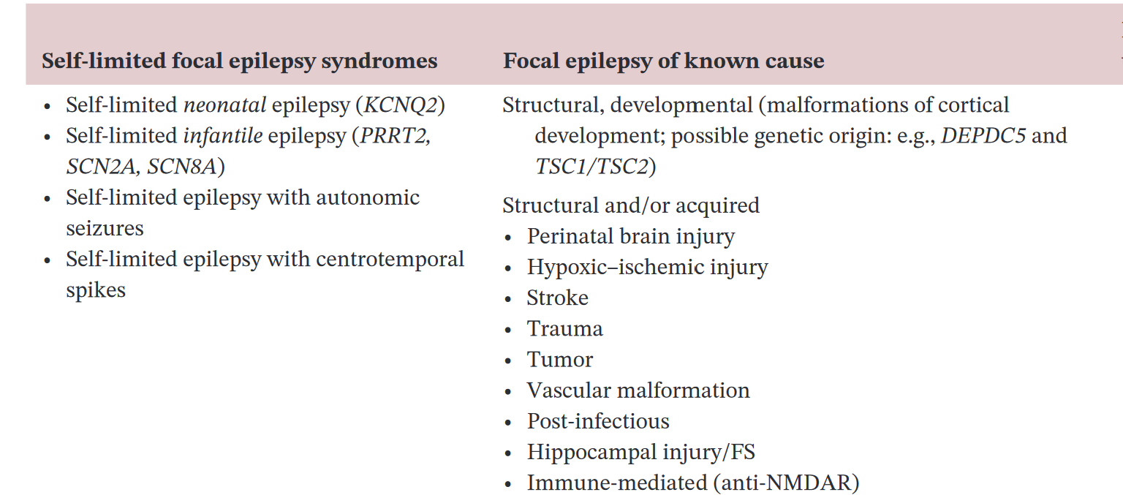
Header
Focal Epilepsy Etiology
In Children
Notes:
Doing chronologically

Slide 21
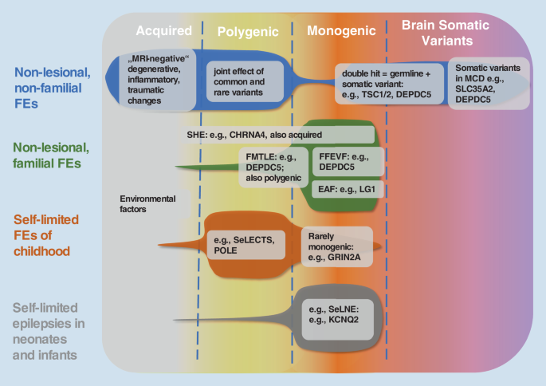
Header
Focal Epilepsy Etiology
In Children
Notes:
Doing chronologically

Slide 22
Header
Focal + Genetic
Notes:
Doing chronologically

Slide 23
Header
Focal + Genetic
MCDs
GATOR-opathies Channelopathies
&
MTOR-opathies
Notes:
Doing chronologically

Slide 24
Neuronal Channelopathies
Benign familial neonatal/infantile epilepsy
Early infantile epileptic encephalopathy
Generalized epilepsy with febrile seizures plus
Generalized epilepsy with paroxysmal dyskinesias
Childhood absence epilepsy
Juvenile myoclonic epilepsy
Nocturnal frontal lobe epilepsy, types 1, 3, 4, and 5
Dravet syndrome
Notes:
Dravet: SCN1A or GABRG2 (encodes GABA receptor) – both lead to reduced excitability of GABAergic neurons leading to brain hyper-excitability. The Nav1.1 channel is preferentially expressed in GABAergic neurons

Slide 25
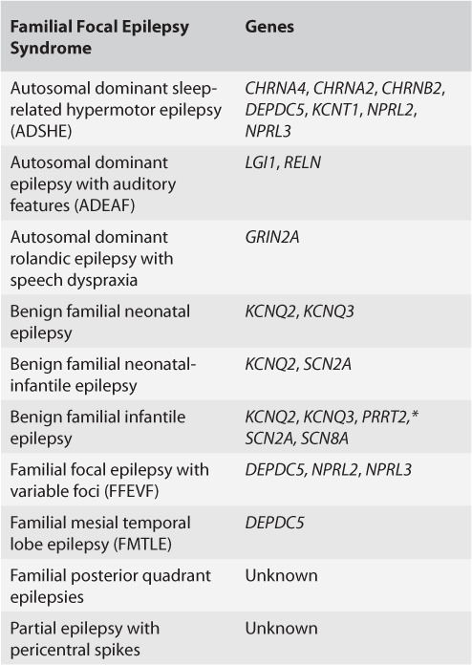
Header
Focal Epilepsy Genes
Notes:
Doing chronologically

Slide 26
Channelopathies: Ligand gated & Voltage-gated channels
Notes:
Ion channels: simply gated pores that allow the passive flow of ions down their gradient.
Ligand gated: channels that are activated by the binding of respective agonists – then lead to the flux of ions
Ex: GABA and glutamate
Voltage gated: activated and inactivated by CHANGES in membrane voltage

Slide 27
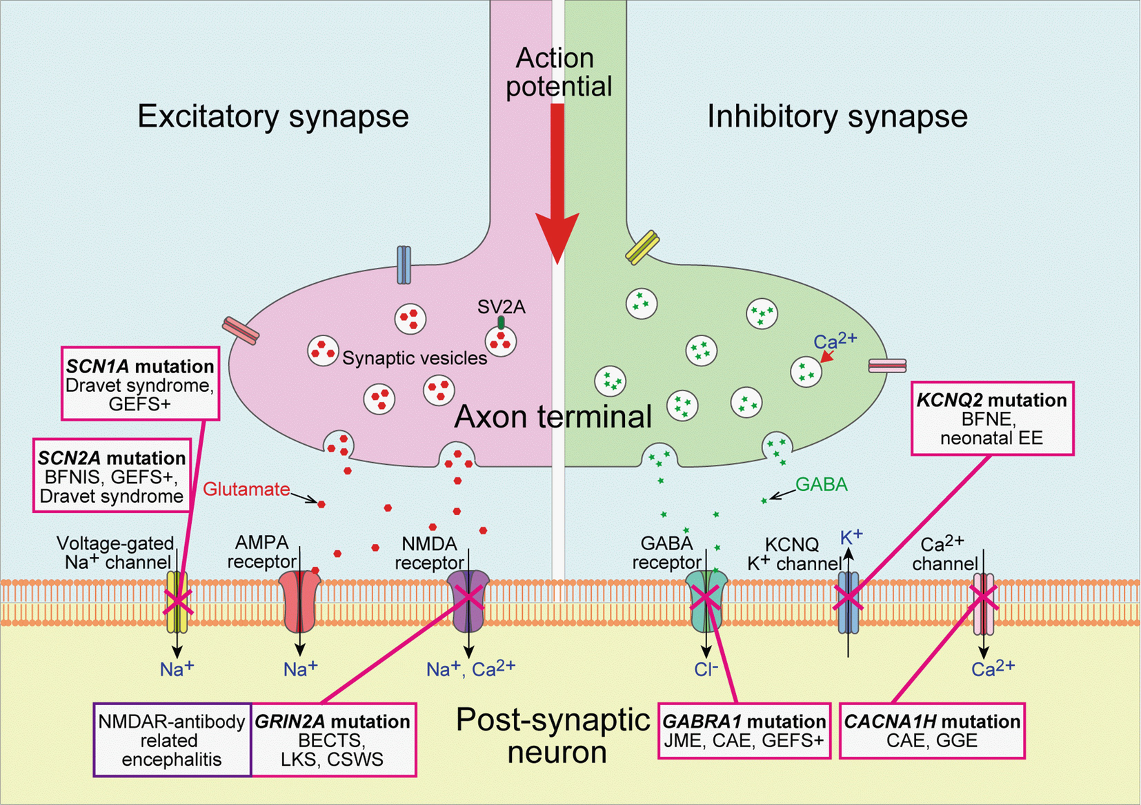
Channelopathies: Ligand gated & Voltage-gated channels
Notes:
Ion channels: simply gated pores that allow the passive flow of ions down their gradient.
Ligand gated: channels that are activated by the binding of respective agonists – then lead to the flux of ions
Ex: GABA and glutamate
Voltage gated: activated and inactivated by CHANGES in membrane voltage

Slide 28
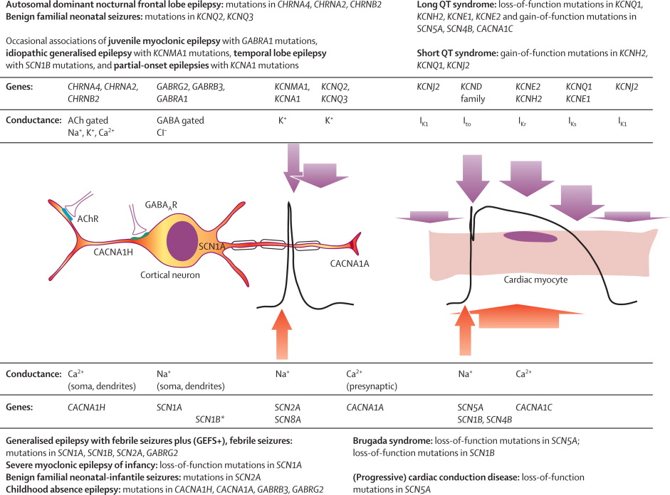
Focal Epilepsy as Channelopathy
Notes:
Dravet: SCN1A or GABRG2 (encodes GABA receptor) – both lead to reduced excitability of GABAergic neurons leading to brain hyper-excitability. The Nav1.1 channel is preferentially expressed in GABAergic neurons

Slide 29
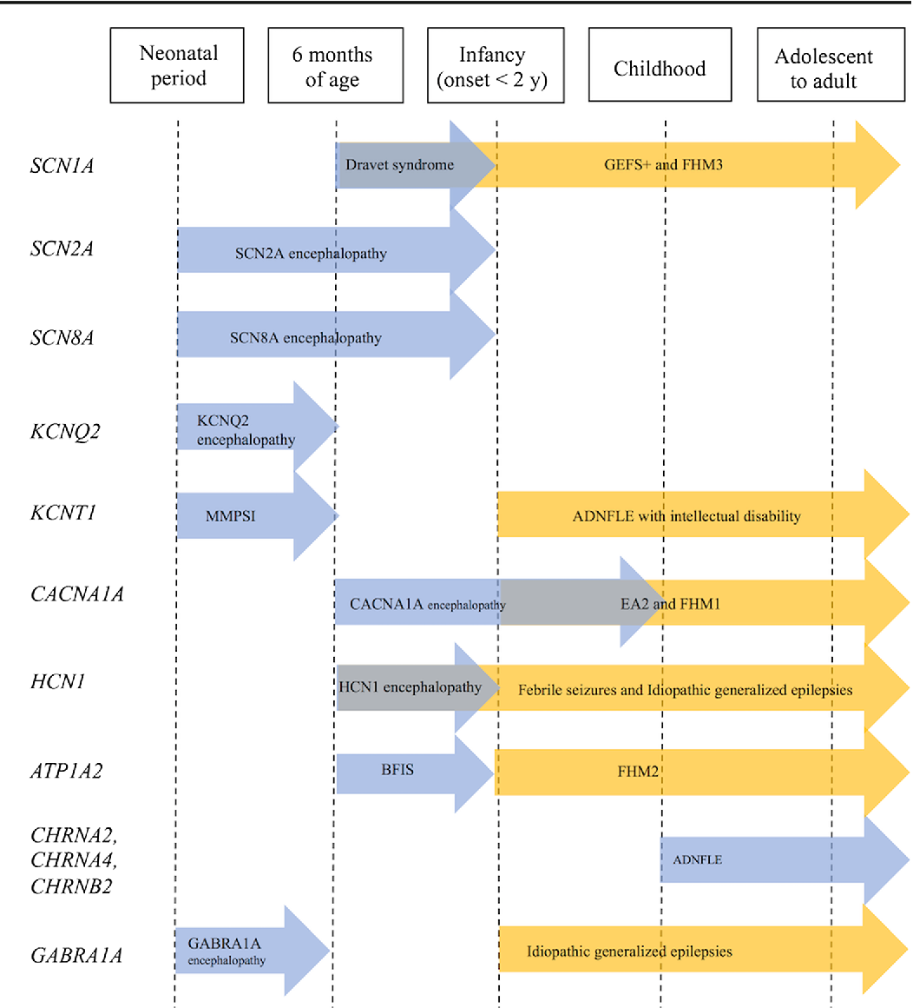
Epilepsy as Channelopathy
Notes:
Dravet: SCN1A or GABRG2 (encodes GABA receptor) – both lead to reduced excitability of GABAergic neurons leading to brain hyper-excitability. The Nav1.1 channel is preferentially expressed in GABAergic neurons

Slide 30
KCNQ2-related Epilepsies
KCNQ2: An ion channel gene, encoding Kv7.2, key for neuronal excitability; traditionally linked to familial neonatal epilepsy and now, neonatal epileptic encephalopathy.
Phenotypes: Two main patient categories - Benign (familial) neonatal epilepsy (BFNE) and Neonatal epileptic encephalopathy (KCNQ2 encephalopathy), with varying degrees of developmental issues.
BFNE: Characterized by brief neonatal seizures in healthy newborns, usually disappearing within the first year; around 10% develop epilepsy later in life.
KCNQ2 Encephalopathy: More severe than BFNE, with hard-to-control seizures, developmental delays, abnormal EEG patterns, and poor developmental outcomes.
Genotype: The impact of KCNQ2 variants ranges from self-limiting neonatal epilepsy to severe developmental disorders. Genotype-phenotype correlations assist in clinical interpretations.
Mechanism: Mutations often lead to a reduction in M-current affecting neuronal excitability; BFNE mutations usually result in a 25% loss, while KCNQ2 encephalopathy mutations often result in a greater loss.
Treatment Implications: Potassium channel opener retigabine is proposed as potential therapy for KCNQ2 encephalopathy, with different treatments potentially beneficial for gain-of-function mutations. More clinical efficacy data is needed.
Notes:
Dravet: SCN1A or GABRG2 (encodes GABA receptor) – both lead to reduced excitability of GABAergic neurons leading to brain hyper-excitability. The Nav1.1 channel is preferentially expressed in GABAergic neurons

Slide 31
KCNT1-related Epilepsies
KCNT1 gene is associated with two distinct genetic epilepsy syndromes:
Migrating Partial Seizures of Infancy (MPSI)
Autosomal Dominant Nocturnal Frontal Lobe Epilepsy (ADNFLE)
ALSO: A/W West syndrome and Ohtahara syndrome
MPSI: a severe epilepsy syndrome starting in the first six months of life
EEG: focal seizures arising independently from various regions of the brain
ADNFLE (with prominent psychiatric symptoms): a familial epilepsy syndrome sleep-related seizures, often frontal onset
KCNT1 is associated with a form of autosomal dominant epilepsy with incomplete penetrance
Quinidine though to counteract the gain-of-function introduced by KCNT1 mutation, and may reduce seizure burden (in ~50% of cases)
Notes:
Dravet: SCN1A or GABRG2 (encodes GABA receptor) – both lead to reduced excitability of GABAergic neurons leading to brain hyper-excitability. The Nav1.1 channel is preferentially expressed in GABAergic neurons

Slide 32
KCNT1 as SLACK
KCNT1 and KCNT2 (AKA SLACK & SLICK) are sodium-activated potassium channels involved in slow hyperpolarization after repetitive neuronal firing, thereby helping return the membrane potential to its resting state.
K-channel family is large (80 members) likely play various roles in different developmental stages.
KCNQ2 and KCNQ3 → important role in the initial months of human life → Pathogenic variants → benign familial neonatal seizures (BFNS).
Role of KCNT1 is not entirely clear
Activating variants increase K current → hyperexcitability
KCNT1 may have additional functions during neuronal development
Notes:
Dravet: SCN1A or GABRG2 (encodes GABA receptor) – both lead to reduced excitability of GABAergic neurons leading to brain hyper-excitability. The Nav1.1 channel is preferentially expressed in GABAergic neurons

Slide 33
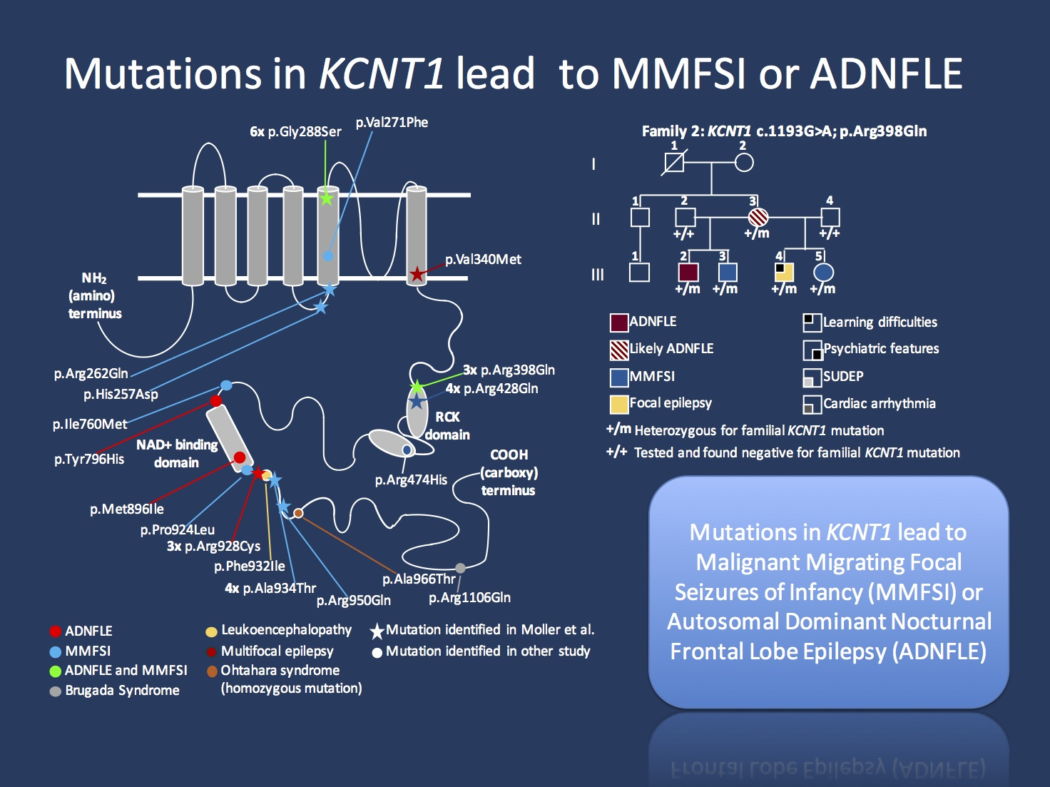
KCNT1-related Epilepsies
Notes:
Dravet: SCN1A or GABRG2 (encodes GABA receptor) – both lead to reduced excitability of GABAergic neurons leading to brain hyper-excitability. The Nav1.1 channel is preferentially expressed in GABAergic neurons

Slide 34
LGI1-related LTLE
LGI1: A gene involved in familial lateral temporal lobe epilepsy (LTLE), an inherited focal epilepsy primarily characterized by auditory or visual seizures. It's commonly seen in familial LTLE but rarely in other epilepsies.
Phenotype: LTLE patients usually experience auditory or acoustic features before a generalized tonic-clonic seizure. Other partial seizures can include receptive aphasia and visual auras. Treatment with antiepileptic drugs like carbamazepine or valproic acid is usually effective.
Genetics: Mutations in LGI1 were first identified in 2002 as a cause for familial LTLE, with the mechanism being mainly haploinsufficiency. Missense mutations tend to cluster in one of the early functional domains of the protein. LGI1 mutations are quite rare in sporadic cases.
Variant Interpretation: LGI1's phenotype is mostly restricted to mild focal epilepsies. Thus, a variant in LGI1 in a patient with a different phenotype may question the relevance of this variant, especially for novel missense variants.
Mechanism: The LGI1 protein, secreted from the presynapse, is a non-ion channel epilepsy. It interacts with ADAM22 and ADAM23, playing a significant role in synaptic maturation by establishing physical contact between the pre- and postsynapse.
Notes:
Dravet: SCN1A or GABRG2 (encodes GABA receptor) – both lead to reduced excitability of GABAergic neurons leading to brain hyper-excitability. The Nav1.1 channel is preferentially expressed in GABAergic neurons

Slide 35
Header
GATOR-opathies, SHE (ADNFLE) & FFEVF
Notes:
Doing chronologically

Slide 36
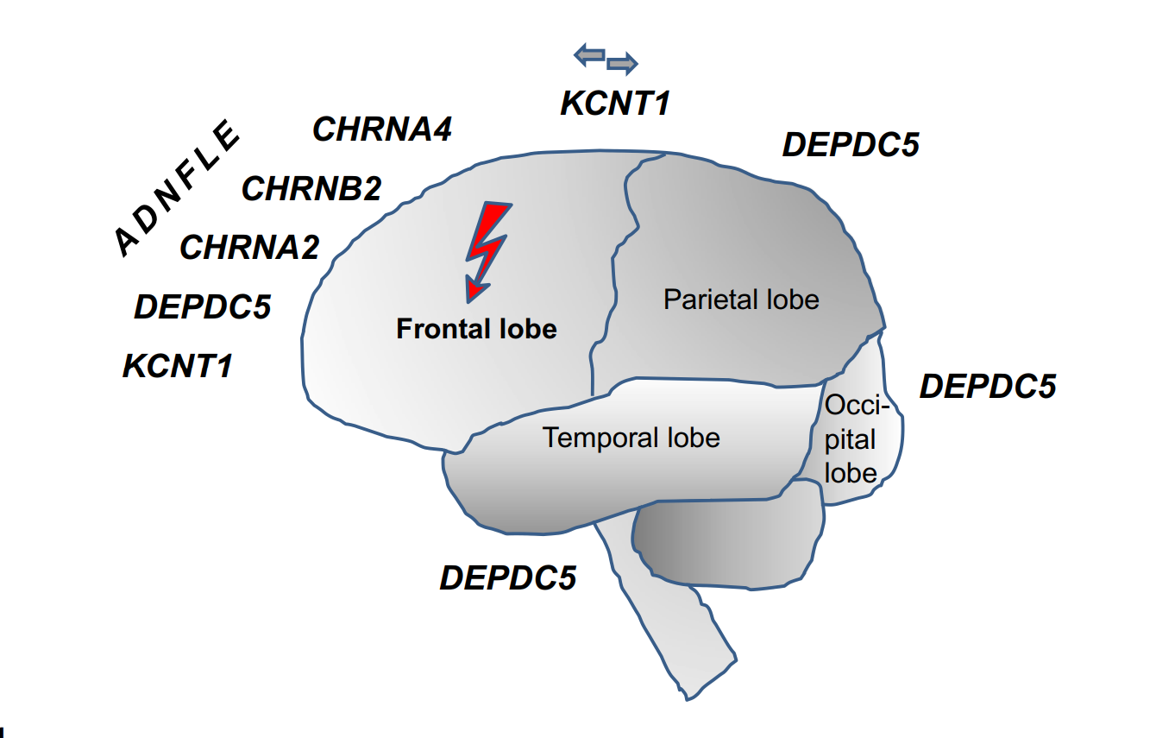
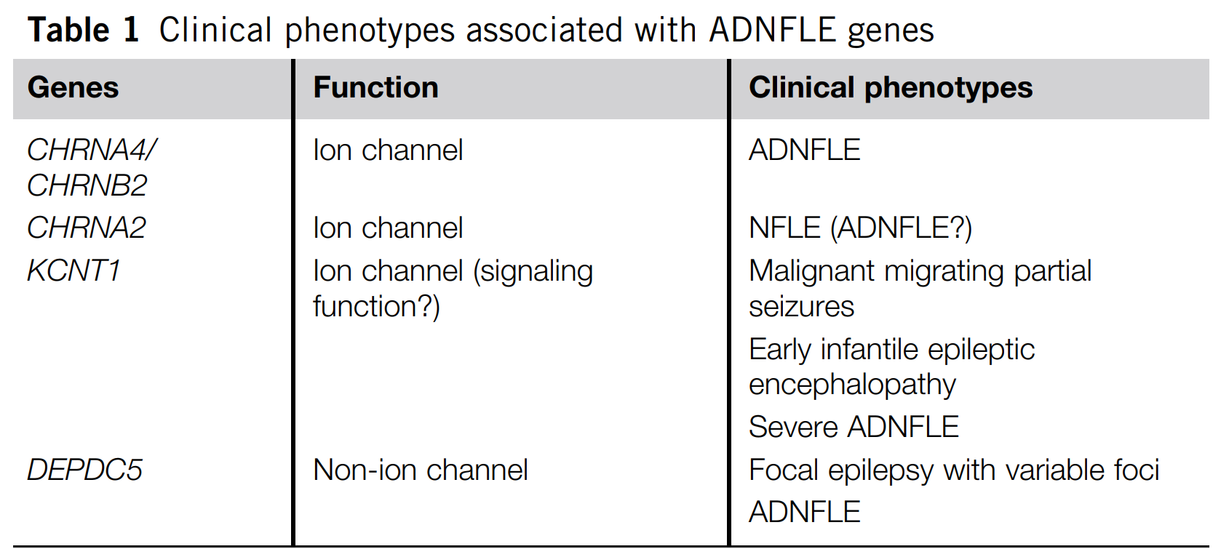
Header
GATOR-opathies, SHE (ADNFLE) & FFEVF
Notes:
Doing chronologically

Slide 37
Header
SHE (ADNFLE) & FFEVF
Autosomal dominant nocturnal frontal lobe epilepsy (ADNFLE) was the first epilepsy linked to specific genetic mutations, primarily found in the subunits of the nicotinic acetylcholine receptor.
Despite its initial categorization as a channelopathy, more recent research has identified other genes, not involved with ion channels, that can also cause ADNFLE.
ADNFLE was first discovered as a distinct epilepsy in 1994, resulting from mutations in the a4-subunit of the neuronal nicotinic acetylcholine receptor and the voltage-gated potassium channel gene KCNQ2, found on chromosome 20q.
The nAChR subunit genes CHRNA4 and CHRNB2 are responsible for the clinical phenotype in about 12–15% of ADNFLE patients.
Mutations in CHRNA4 and CHRNB2 usually cause amino acid changes in the second transmembrane domain of the proteins, altering the ion channels' function.
Significant interindividual variation in clinical phenotypes associated with ADNFLE, with patients presenting different symptoms, onset ages, and responses to antiepileptic drugs.
Severity of the disorder and the associated symptoms vary greatly depending on the specific mutation involved, notably between the mutations CHRNA4-Ser280Phe and CHRNA4-Ser284Leu.
Carbamazepine, an antiepileptic drug, has been found effective in patients carrying CHRNA4-Ser280Phe mutation but not as effective for those with the CHRNA4-Ser284Leu mutation.
Notes:
Doing chronologically

Slide 38
Header
GATOR-opathies
Notes:
Doing chronologically

Slide 39
Header
GATOR-opathies
The GATOR1 complex (DEPDC5, NPRL2, and NPRL3) is a regulator of the mTORC1 signaling pathway.
GATOR1 plays a key role in neuronal cell proliferation, differentiation, and the formation of neural networks.
Variants of DEPDC5, NPRL2, and NPRL3 are associated with a series of focal epilepsy syndromes, referred to as the "GATOR1 phenotype.“
Notes:
Doing chronologically

Slide 40
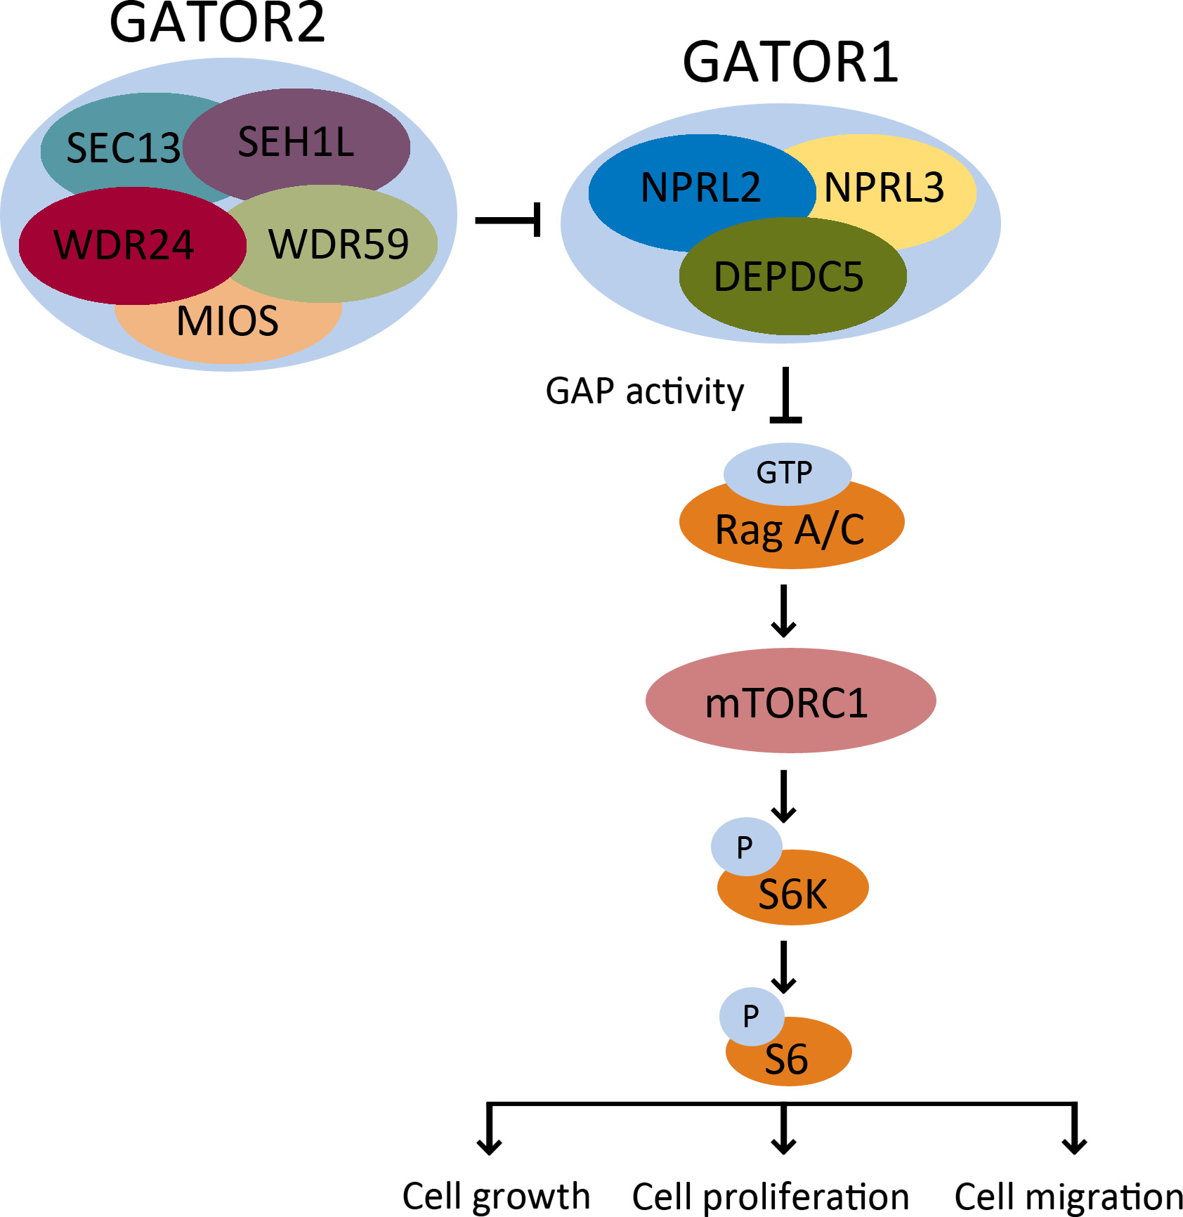
Header
Header
Header
GATOR-opathies
DEPDC5
NPRL2
NPRL3
Notes:
Doing chronologically

Slide 41
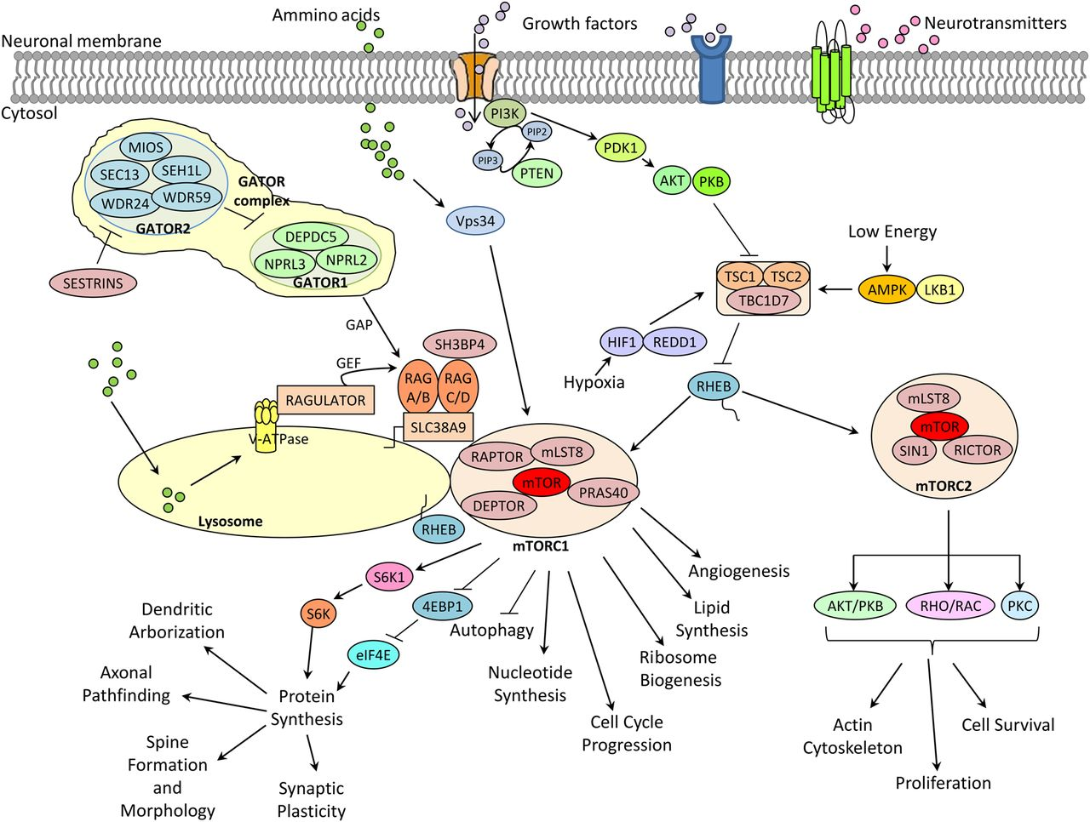
Header
Header
Header
GATOR-opathies
Notes:
Doing chronologically

Slide 42
Header
Header
Header
GATOR-opathies
Notes:
Doing chronologically

Slide 43
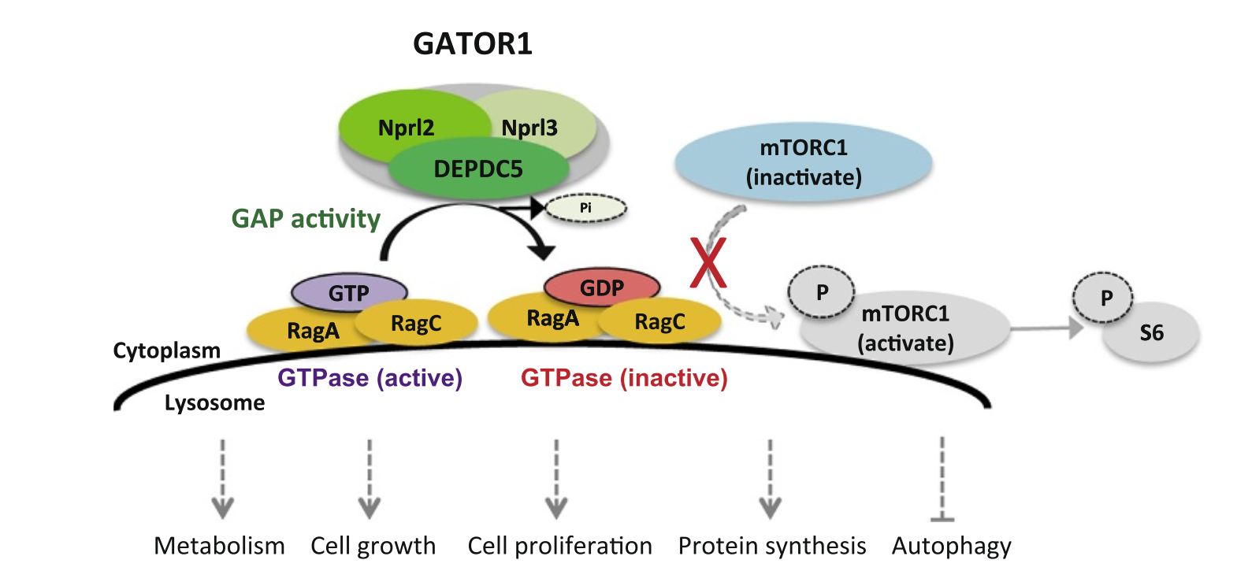
Header
Header
Header
GATOR-opathies
Notes:
Doing chronologically

Slide 44
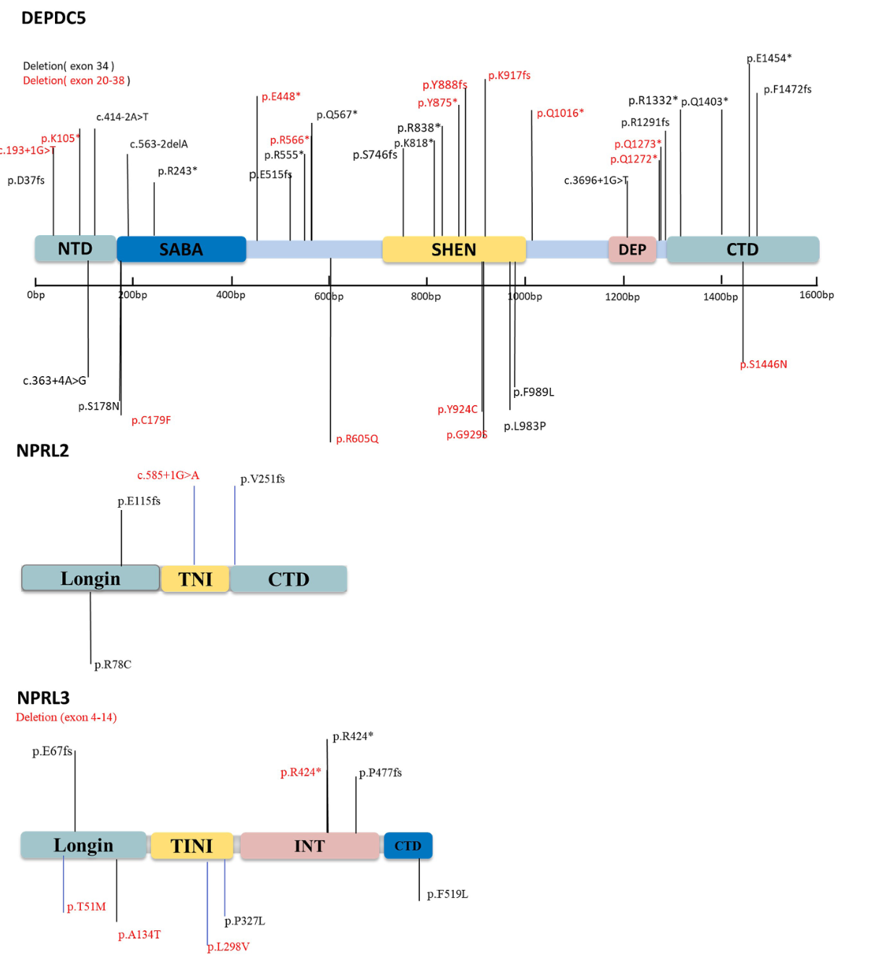
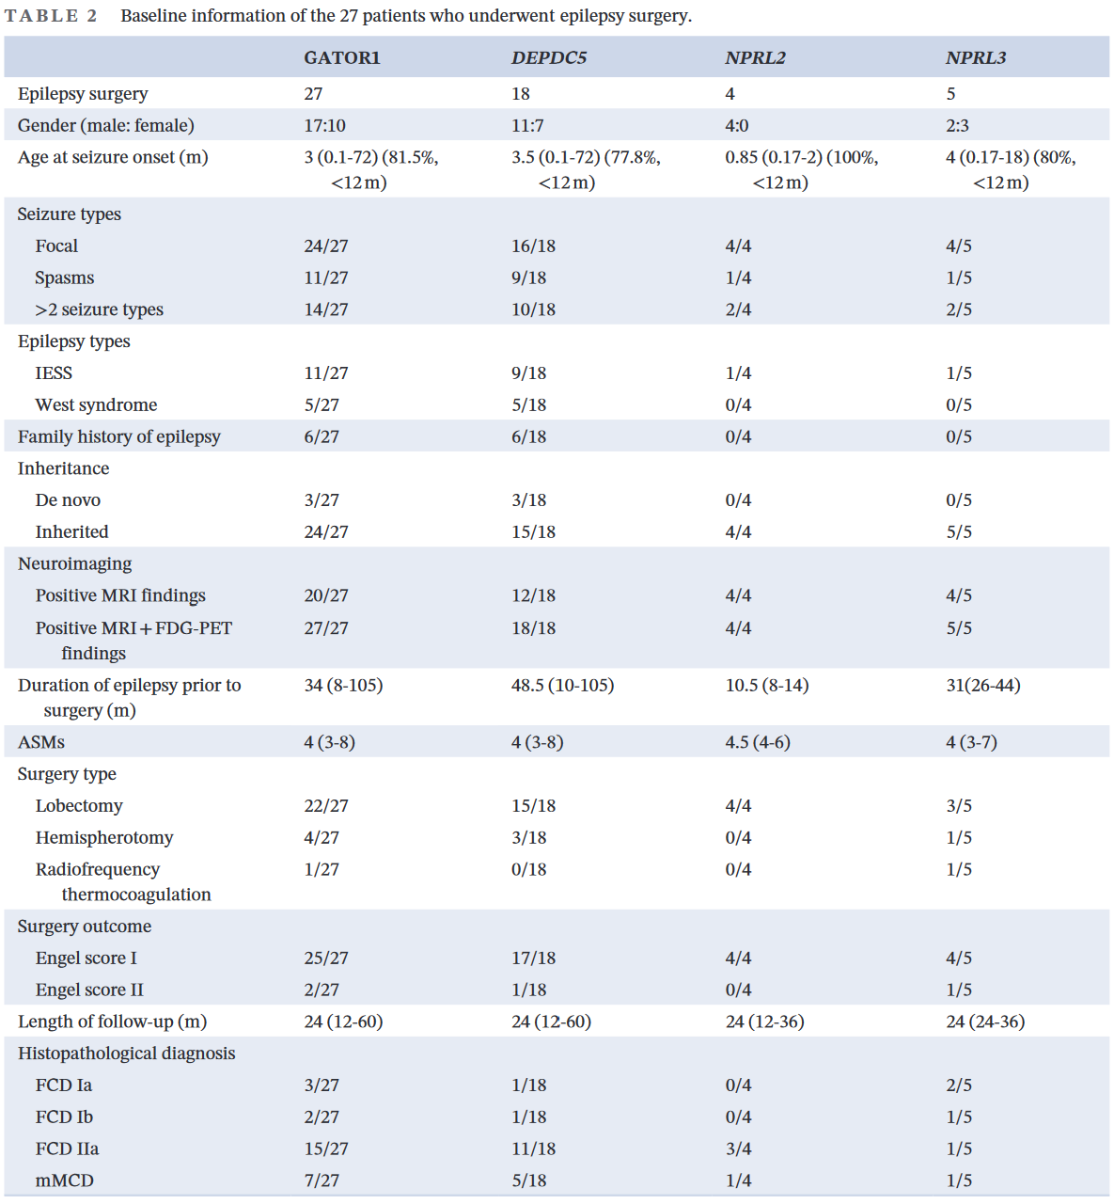
Header
Epilepsia Open. 2023;00:1–11. |1wileyonlinelibrary.com/journal/epi4Received: 15 November 2022 |Accepted: 26 May 2023DOI: 10.1002/epi4.12770 ORIGINAL ARTICLESeizure features and outcomes in 50 children with GATOR1 variants: A retrospective study, more favorable for epilepsy surgeryHao Wang
Notes:
**Introduction**- The GATOR1 complex, which includes DEPDC5, NPPL2, and NPRL3, is a regulator of the mTORC1 signaling pathway.- GATOR1 plays a key role in neuronal cell proliferation, differentiation, and the formation of neural networks.- Variants of DEPDC5, NPRL2, and NPRL3 are associated with a series of focal epilepsy syndromes, referred to as the "GATOR1 phenotype."- Nearly 50% of patients with GATOR1 variants are drug-resistant.- Malformations of cortical development (MCD) are common in patients with GATOR1 variants and are a common cause of drug resistance.- Favorable epilepsy surgery outcomes have been reported in patients with GATOR1 variants, with nearly 50%-60% achieving seizure freedom after surgery.**Clinical Features**- Reviewed the clinical and genetic data of 50 Chinese children with epilepsy caused by GATOR1 variants.- 31 boys and 19 girls, median age at epilepsy onset was 4 months, and 64% had early-onset epilepsy (≤1 year).- 24% of the probands had a family history of epilepsy.- Most common epileptic seizure type was focal seizures.**Seizure Outcomes and Prognostic Factors**- 92% of patients were drug-resistant epilepsies after initial ASMs treatment, only 8% achieved seizure freedom.- 27 patients underwent epilepsy surgery, 92.6% were seizure-free at the last follow-up (1-5 years after surgery).- Histological examinations confirmed FCD in 20 probands, including three with FCD Ia, two with FCD Ib, and 15 with FCD IIa. Mild MCD (mMCD) was reported in the other seven patients.- Factors affecting prognosis included a higher percentage of neuroimaging abnormality (P<0.001), and a higher percentage of undergoing epilepsy surgery (P<0.001).- Among patients with positive neuroimaging findings, patients with seizure-free also had more percentage of undergoing epilepsy surgery (P<0.001).**Genetic Results and Genotype-Phenotype Correlation**- 49 GATOR1 variants were identified, 37 were novel mutations.- Variants distribution: DEPDC5 (37 patients, 74%), NPRL3 (9 patients, 18%), NPRL2 (4 patients, 8%).- Similar phenotype observed in patients with DEPDC5, NPRL2, or NPRL3 variants.- Only 12% of variants were de novo, 40 from asymptomatic parents, and four from parents with epilepsy or febrile seizures.- 70% of variants were classified as pathogenic (P) or likely pathogenic (LP) according to the new ACMG guidelines.- No statistically significant differences were found in phenotype and seizure outcome between the ACMG P/LP and ACMG VUS groups.**Methods and Results**- Identified 50 patients (29 males, 21 females) with epilepsy caused by GATOR1 variants.- Median age at seizure onset was 6 months.- 38 of the 50 patients had Infantile epileptic spasm syndrome (IESS), 32 also had a diagnosis of West syndrome.- Most common seizure type was focal seizures.- A total of 50 GATOR1 variants were identified in the 50 patients.- 24 of the 50 patients had abnormal neuroimaging findings, most common was MCD.- 45 patients received anti-seizure medication (ASM) treatment, 29 had drug-resistant epilepsy.- 20 patients underwent epilepsy surgery, 14 achieved seizure freedom after surgery.- 30 (60%) were seizure-free at the last follow-up, seizure-free rate was 70% for those who underwent epilepsy surgery.- Postoperative pathology was significantly associated with seizure outcome (P < 0.01).

Slide 45
Header
GATOR-opathies
The GATOR1 complex (DEPDC5, NPRL2, and NPRL3) is a regulator of the mTORC1 signaling pathway.
GATOR1 plays a key role in neuronal cell proliferation, differentiation, and the formation of neural networks.
Variants of DEPDC5, NPRL2, and NPRL3 are associated with a series of focal epilepsy syndromes, referred to as the "GATOR1 phenotype.“
Variants distribution: DEPDC5 (37 patients, 74%), NPRL3 (9 patients, 18%), NPRL2 (4 patients, 8%).
Nearly 50% of patients with GATOR1 variants are drug-resistant.
Nearly 50% had abnormal neuroimaging
Malformations of cortical development (MCD) & FCDS are common in patients with GATOR1 variants
Focal seizures are the most common seizure type
Majority of patients present with first seizure <12mo
Favorable epilepsy surgery outcomes have been reported in patients with GATOR1 variants, with nearly 50%-60% achieving seizure freedom after surgery.
Similar phenotype observed in patients with DEPDC5, NPRL2, or NPRL3 variants.
Only 12% of variants were de novo, 40 from asymptomatic parents, and four from parents with epilepsy or febrile seizures.
Notes:
Doing chronologically

Slide 46
Header
DEPDC5
DEPDC5 is the most common familial focal epilepsy gene (up to 12% ?)
Associated with AD familial focal epilepsy with variable foci & ADNFLE
Each individual within a family can have different types of focal epilepsies, most frequently frontal lobe epilepsy.
DEPDC5 is part of the GATOR1 subcomplex, which modulates mTOR activity dependent on the availability of amino acids. Haploinsufficiency of DEPDC5 → decreased inhibition of mTOR → leading to cortical dysplasia in varying locations (2 Hit hypo?)
Pathogenic DEPDC5 mutation → 50-80% likelihood of developing focal epilepsy.
Treatment options for DEPDC5 mutations include standard options such as drug treatment and epilepsy surgery
mTOR inhibitors, like rapamycin, has been suggested, but as of the date of the text, no studies support their use in patients with DEPDC5 mutations.
Notes:
Doing chronologically

Slide 47
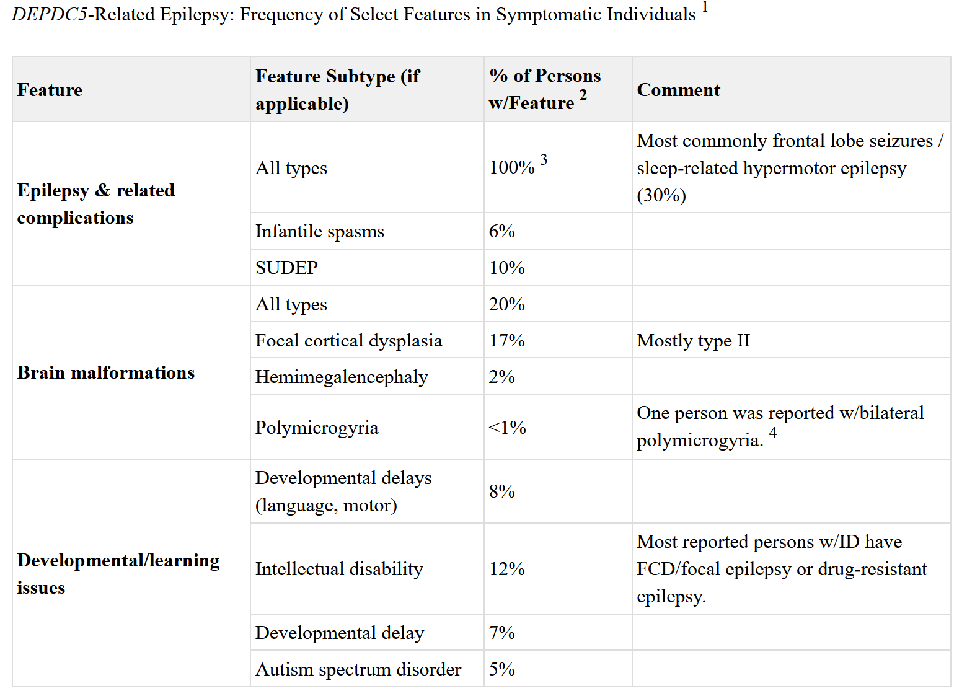
Header
DEPDC5
Notes:
Doing chronologically

Slide 48
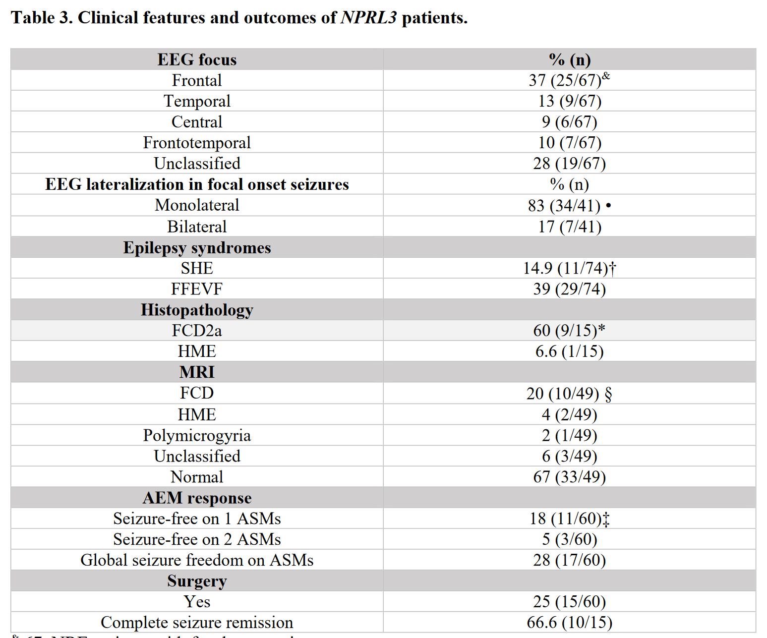
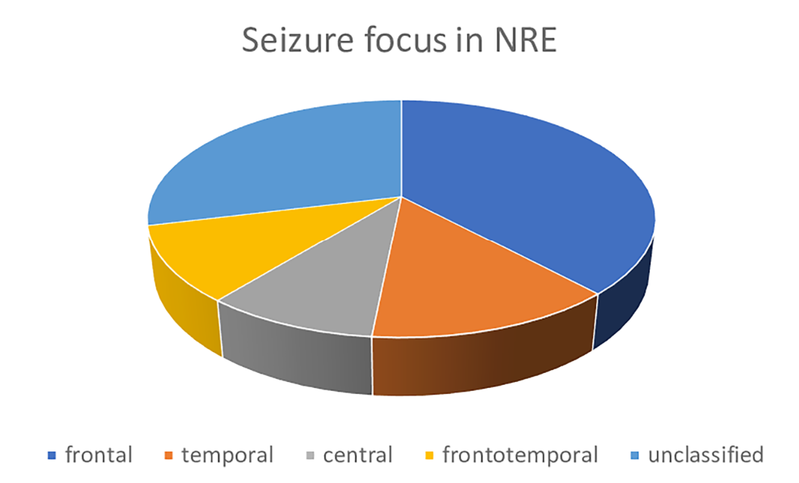
Header
NPRL-related Focal Epilepsy
Refining the electro-clinical spectrum of NPRL3-related epilepsy: a novel multiplex family and literature review
Notes:
Doing chronologically

Slide 49
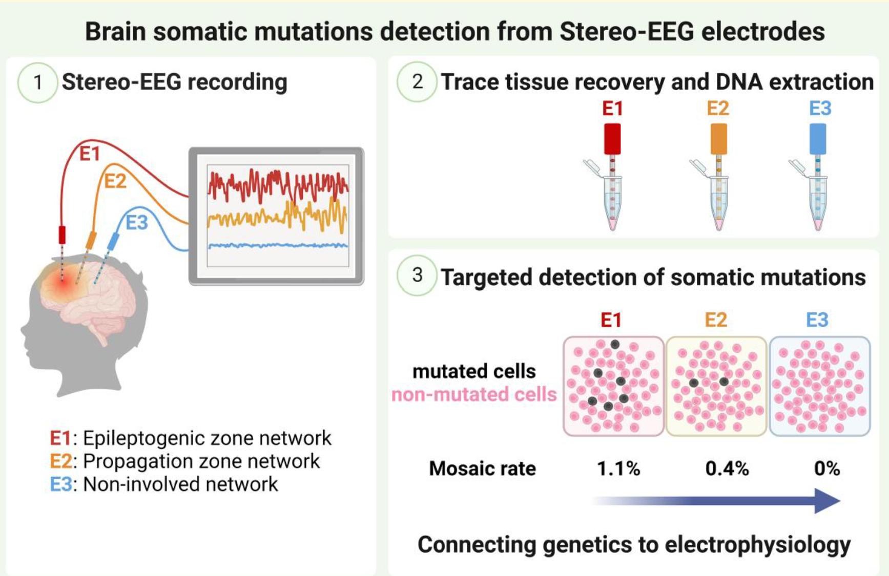
Header
Somatic/Brain Mosaicism
Detection of brain somatic mutations in focal cortical dysplasia during epilepsy presurgical Workup. BRAIN COMMUNICATIONS 2023:
. Rayann Checri. https://doi.org/10.1093/braincomms/fcad174
Notes:
y targeted gene panel sequencing on bulk DNA from the
resected brain tissue, we identified two-hit loss-of-function
mutations in DEPDC5 (NM_001242896.3): a germline het-
erozygous start-loss mutation c.2_6delAGATG (p.? ) and a
somatic loss-of-function p.R843* variant. The germline
variant was classified as ‘likely pathogenic’ based on the
American College of Medical Genetics (ACMG) guide-
lines,18 and the somatic variant was classified as ‘pathogenic’
based on the recently published guidelines for pathogenicity
classification of somatic alterations in tumors.19 The VAF of
the somatic p.R843* ranged from 7% in the precentral cor-
tex to 5% in the cingulate gyrus.
We subsequently assessed the presence of the somatic
DEPDC5 p.R843* variant in each electrode by targeted am-
plicon sequencing (without genomic pre-amplification), and
tested mutation-negative controls to account for possible
sequencing artifacts. In mutation-negative controls, we cal-
culated a technical false-positive VAF of 0.19% (range
0.11–0.28%). Only one electrode (CA) was considered
mutation-positive, with a VAF of 0.39% (significantly above
the false-positive rate, P = 0.002). The electrode CA was in a
cortical area involved in the propagation zone network and
adjacent to the border of the previously resected dysplasia However, we did not confidently identify
the DEPDC5 somatic mutation on the two electrodes that
were in the epileptogenic zone network (the VAF was below
the confidence threshold).

Slide 50
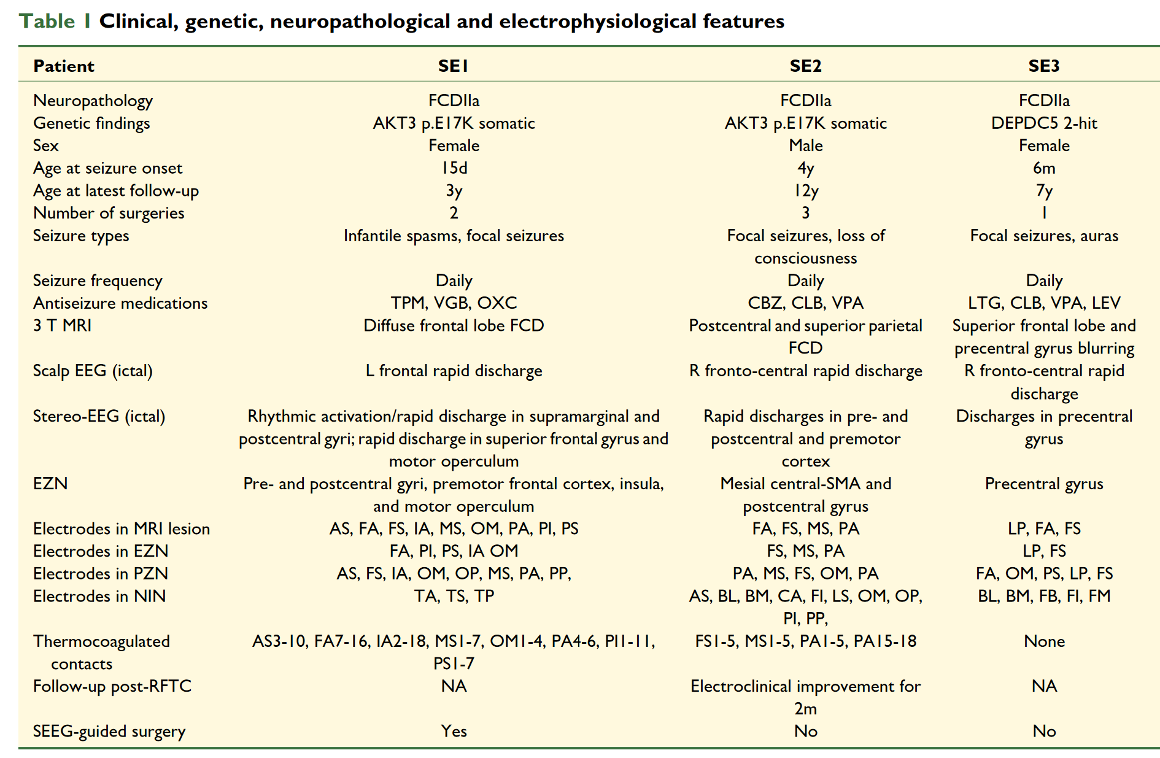
Header
Somatic/Brain Mosaicism
Detection of brain somatic mutations in focal cortical dysplasia during epilepsy presurgical Workup. BRAIN COMMUNICATIONS 2023:
. Rayann Checri. https://doi.org/10.1093/braincomms/fcad174
Notes:
y targeted gene panel sequencing on bulk DNA from the
resected brain tissue, we identified two-hit loss-of-function
mutations in DEPDC5 (NM_001242896.3): a germline het-
erozygous start-loss mutation c.2_6delAGATG (p.? ) and a
somatic loss-of-function p.R843* variant. The germline
variant was classified as ‘likely pathogenic’ based on the
American College of Medical Genetics (ACMG) guide-
lines,18 and the somatic variant was classified as ‘pathogenic’
based on the recently published guidelines for pathogenicity
classification of somatic alterations in tumors.19 The VAF of
the somatic p.R843* ranged from 7% in the precentral cor-
tex to 5% in the cingulate gyrus.
We subsequently assessed the presence of the somatic
DEPDC5 p.R843* variant in each electrode by targeted am-
plicon sequencing (without genomic pre-amplification), and
tested mutation-negative controls to account for possible
sequencing artifacts. In mutation-negative controls, we cal-
culated a technical false-positive VAF of 0.19% (range
0.11–0.28%). Only one electrode (CA) was considered
mutation-positive, with a VAF of 0.39% (significantly above
the false-positive rate, P = 0.002). The electrode CA was in a
cortical area involved in the propagation zone network and
adjacent to the border of the previously resected dysplasia However, we did not confidently identify
the DEPDC5 somatic mutation on the two electrodes that
were in the epileptogenic zone network (the VAF was below
the confidence threshold).

Slide 51
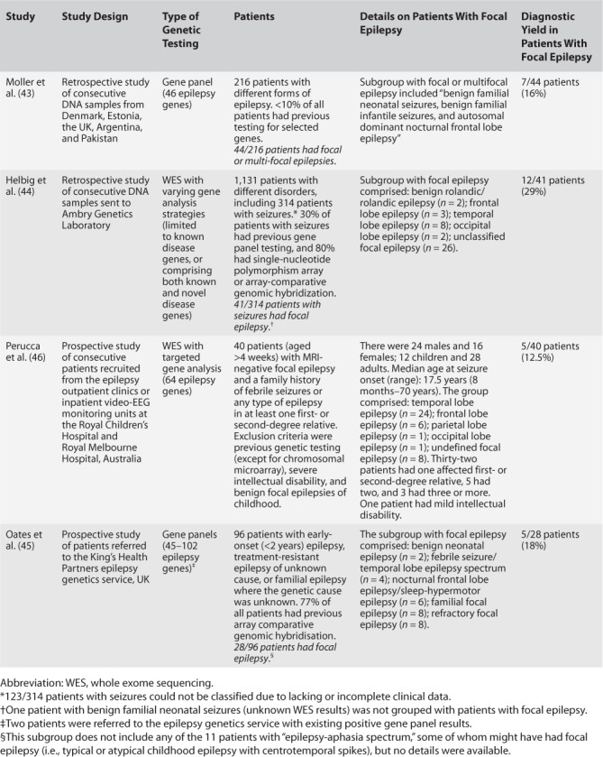
Header
Focal Epilepsy & Genetic Testing Yields
Notes:
Doing chronologically

Slide 52
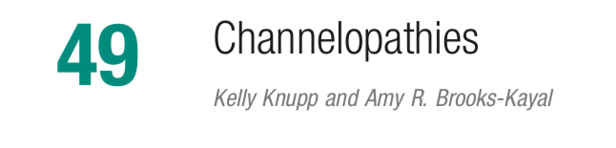

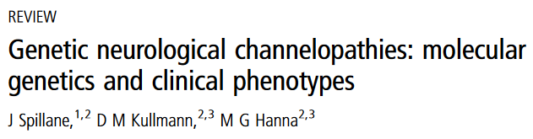
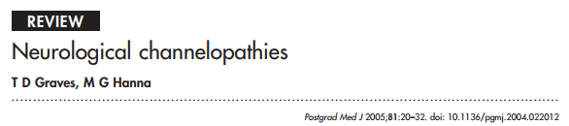
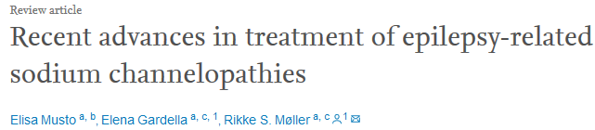
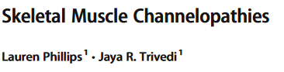
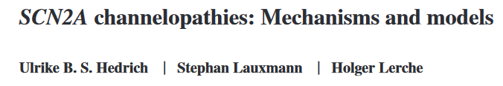

Slide 53
Header
Notes:
Doing chronologically

Slide 54
Header
Notes:
Doing chronologically

